Slide 1
Presentation On Xente Fraud Detection project
Presented By:
Ejifolabi Emmanuel Oludare

Slide 2
INTRODUCTION
Objective:
Evaluation:
The objective of this project is to create a machine learning model to detect fraudulent transactions. Fraud detection is an important application of machine learning in the financial services sector. This solution will help Xente provide improved and safer service to its customer
The error metric for this competition is the F1 score, which ranges from 0 (total failure) to 1 (perfect score). Hence, the closer the score is to 1, the better the model. F1 Score: A performance score that combines both precision and recall. It is a harmonic mean of these two variables. Formula is given as: 2*Precision*Recall/(Precision + Recall) Precision: This is an indicator of the number of items correctly identified as positive out of total items identified as positive. Formula is given as: TP/(TP+FP) Recall / Sensitivity / True Positive Rate (TPR): This is an indicator of the number of items correctly identified as positive out of total actual positives.

Slide 3
DATA INSPECTION
Data Overview:
Summary Statistics:
After Importing all necessary libraries and loading the dataset, it was observed that:
The dataset contain 95,662 numbers of rows or entries.
The dataset has 16 numbers of Columns.
The features are 15 in numbers e.g. TransactionId, AccountId, BatchId, CountryCode, CurrencyCode, Pricing Strategy, ProductId,Product category e.t.c.
The target variable is FraudResult and is contains only two categories of values which are 0 (Non-Fraud) and 1 (Fraud).
The Statistical Analysis shows that :
The mean transaction recorded on the dataset is seen to be 6717 UGX.
The values on the “Value” column is closely aligned with the values in the “Amount” column.
The pricing strategy used for transactions is set to be 0, 1, 2 and 4. Pricing Strategy 2 recorded the highest transactions.
The statistics shown that notable outliers are present in the data.
The dataset has zero missing values.
Initial Insights:
The dataset focuses on Ugandan Currency Transactions.
Non Fraud category dominate the dataset

Slide 4
DATA CLEANING
Data Integrity Check:
Handling Outliers:
The integrity of the data was checked thoroughly and it was observed that:
The dataset contain zero NonNull or missing values
No duplicate record was found on the dataset.
It was observed that Amount and Value columns have very high amount of outliers and it was known by plotting a boxplot for the visualization.
The technique used to deals with the outliers was Inter-Quartile Range. The value lesser than the lower limit was replaced with the lower limit and the values greater than the upper limit was replaced with the upper limit.
Boxplot was used again to confirm if the outliers are gone .
Keynote: the outliers on Pricing strategy and FraudResult were not clean because, they were not outliers in real sense.
Datatype Conversion:
Data Columns were subsect to be assigned to variable that will contain each of the datatype and the columns were subsect as below:
Variable name “date” for Datetime datatype.
Variable name “cat” for Categorical datatype.
Variable name “num” for Numerical datatype.
Iterative approach was used to convert columns to its respective datatypes.

Slide 5
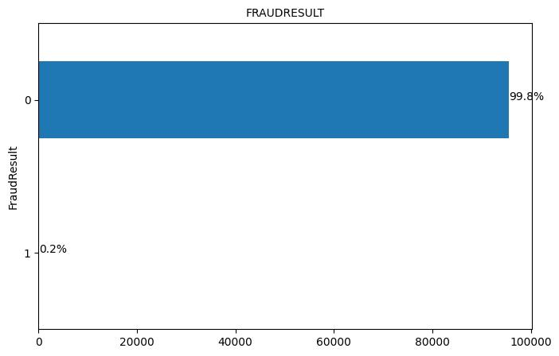
EXPLORATORY DATA ANALYSIS (EDA)
Target Variable Distribution:
Feature Variables:
The plot shown below shows that
Exactly 99.98% of the target variable values are Non-Fraud.
Very small values which is 0.2% of the transactions are Fraud.
The plot from the EDA also confirmed that,
Product with ID 3 recorded approximately 60% of the transactions.
Base on the Product Category, Product name “Transport” and “Ticket” has the highest price tag.
Based of transaction deals with by Providers, Provider_3 deals with the highest number of transaction which Provider_1 is relatively closed to Provider_3. The plot shown that Provider_4 is likely to be in-charge of providing Pay On Credit transactions.
Based on Customer’s transaction, Customers_Id 4841 recorded the highest number of transactions with about 39893 transactions.
The next slide will show part of the plot achieved from the EDA section of the project.

Slide 6
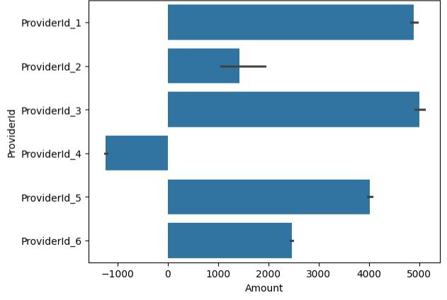
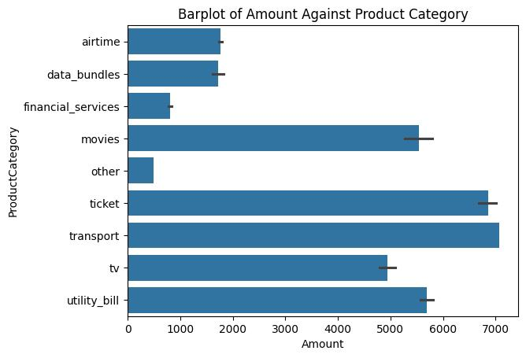
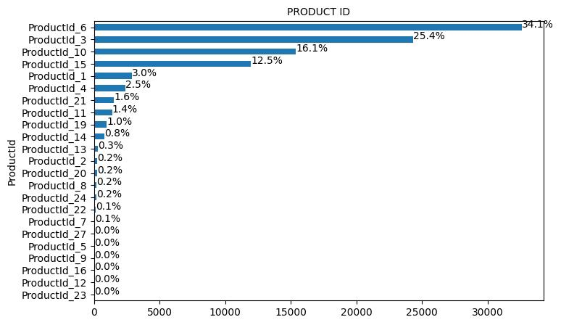
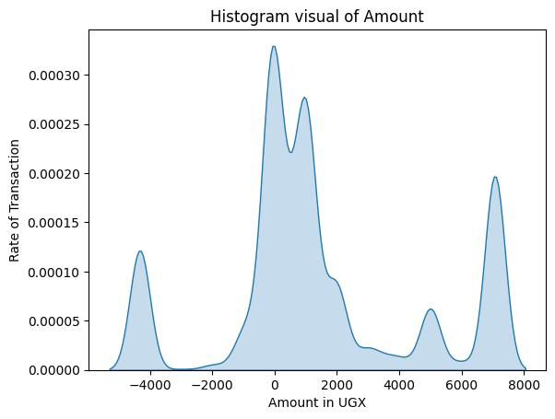
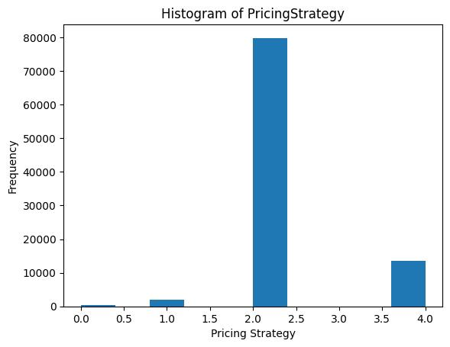
EDA PLOTS
Product ID

Slide 7
FEATURE ENGINEERING
Feature Creation
Feature Selection
Five new features were created from existing features. The Feature from which the five new features were created from is the TransactionStartTime. The Features created are:
TransactionYear
TransactionMonth
TransactionDay
TransactionHour and
Transaction DayOfWeek
In order to have a good model performance, some feature are irrelevant to the model and was dropped. The feature are:
TransactionId,
SubscriptionId,
CurrencyCode,
CountryCode,
TransactionStartTime.

Slide 8
DATA PREPROCESSING
Transformation Techniques
In other to have good data on which the model can train:
The categorical datatype were converted to numerical values. The technique used was LabelEncoder.
In order to have a dataset which follow the same scale, MinMaxScaler was used to set the minimum value to 0 and maximum value to 1
The dataset is divided into features and target.

Slide 9
DATA IMBALANCING
Class Imbalance Handling
For a model to train well in all aspect of the dataset, all data must be balanced. Since it was observed earlier that the target variable contains 99.98% of 0 and just 0.2% of 1, it is a must to balance the data points so that the model can learn on both cases. The technique used was oversampling techniques and it was done by using SMOTE imported from Imblearn module. The minority was oversampled to have equal values with the majority.
The data was then divided to training and testing after the sampling:
70% for training and
30% for testing.

Slide 10
MACHINE LEARNING
Model Development
Model Training
Developing a machine learning model that will be capable of detecting fraudulent transactions is the objective of the project. In order to achieve it, the following Classifiers are selected for the model development:
Decision Tree Classifier
Random Forest Classifier
K-Nearest Neighbor Classifier
Support Vector Machine (SVM)
All model trained on the data and used for predictions.
Evaluation Metrics
The key metrics for the model evaluation are:
F1 Score
Precision
Recall
Random Forest Classifier outperform all other models in all aspect.

Slide 11
COMPARATIVE ANALYSIS
Model Performance Comparison
Models Strengths and Weaknesses
Random Forest Classifier achieved the highest F1 score, precision and accuracy, which make it stands out among other models.
Support Vector Machine achieved the highest recall of 1. It stands out among all other models.
Decision Tree Classifier:
Strength:- It’s very good at making correct predictions (almost 100% accuracy).
Weakness:- It might learn well and might not perform well on new data.
Random Forest Classifier:
Strengths:
It’s the best at making correct predictions.
It’s very reliable in finding fraud

Slide 12
COMPARATIVE ANALYSIS
Weakness:- It takes longer time to train on data than decision tree.
K-Nearest Neighbor Classifier:
Strength: It catches all the fraud cases (100% recall.
Weakness: It’s slow in making predictions.
Support Vector Machine (SVC):
Strength:
It’s very good at making correct predictions and catches all the fraud cases (100% recall).
It’s good at separating fraudulent transactions from non fraudulent transactions.
Weakness: It takes longer to train because of its complexity.

Slide 13
CONCLUSION
Among all the model evaluated, Random Forest perform the best. It achieved the highest accuracy and maintained perfect balance between precision and recall. It ability to perform more than other models make it suitable for fraud detection.
Recommendation:
For the best performance in fraud detection, Random Forest is the recommended model due to superior accuracy and reliability. If computational resources or speed are in concern, Decision Tree are simpler and faster alternative while still performed well.
Choosing RandomForest Classifier will provide the best balance of accuracy, reliability and robustness for the fraud detection needs.

Slide 14
Thanks

